Slide 1
Using Logical Title Level Collections
Yoel Kortick May 2024

Slide 2
Agenda
Introduction
Creating the Logical Query
Creating the Logical Collection
Attributing a Set to the Logical Collection
Ongoing Update of the Collection From the Set
The Logical Title Level Collection in Discovery

Slide 3
Introduction

Slide 4
Introduction
When a title level collection is not defined as “logical” titles can be added to the title level collection in the following ways:
    Manually one at a time from the “Title List” tab of the collection by clicking “Add Title”
    Manually from a set from the “Title List” tab of the collection by clicking “Add Titles from Set”
    Via an Import Profile of type “Digital” by choosing the title level collection in the “Inventory Information” tab

Slide 5
Introduction
When a title level collection is defined as “logical” titles are assigned to collections automatically.
The assignment of titles to a title level collection is based on a logical query instead of assigning them manually. This is a significant timesaver.
This is done by defining the Title Level Collection to be logical.
The title level collection is considered a “Logical Collection” when the new “Logical Collection” checkbox is checked on the “Add New Collection page”.
This is accessed when creating a new title level collection at “Resources > Manage Inventory > Manage Collections”.

Slide 6
Introduction
Any time a new title is added to or removed from the logical set it will also get added to or removed from the Logical Title Level Collection.
This eliminates the need to manually add a title or manually click “Add Titles from Set”
Note that it is possible to add records with any type of inventory (or no inventory) to title level collections.
See also the online help Adding a Logical Collection on the Ex Libris Knowledge Center.

Slide 7
Creating the Logical Query

Slide 8
Creating the Logical Query
The logical query is determined by the query of a titles set (Digital Titles, Electronic Titles, Physical Titles or All Titles).
In our example here we will use a logical set of type “All Titles”.
First, we will create a set of all titles where “Subject contains phrase Library Science”.
Then we will attribute the logical set to a Logical Title Level Collection.

Slide 9

Creating the Logical Query
Here we are searching for all titles where (Subjects contains phrase "Library Science")

Slide 10
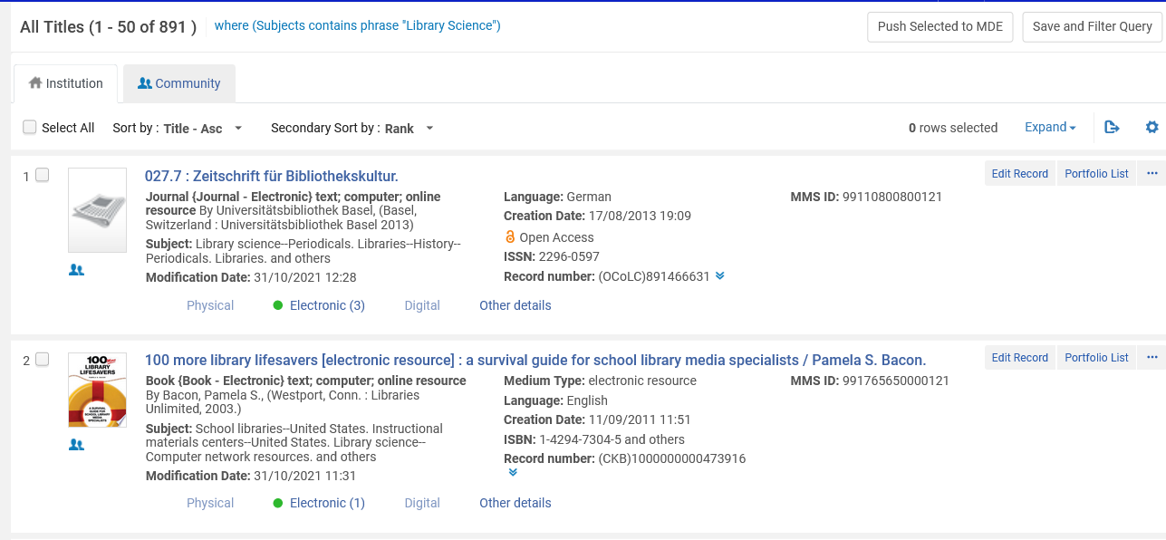
Creating the Logical Query
From the results we will click “Save Filter and Query” to create a logical set

Slide 11
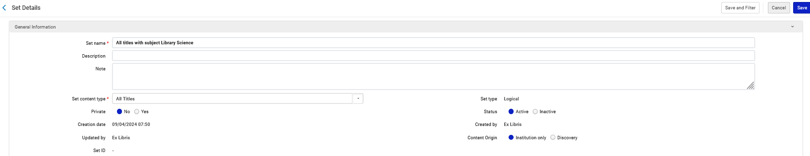
Creating the Logical Query
We will call our All Titles Logical Set “All titles with subject Library Science”

Slide 12
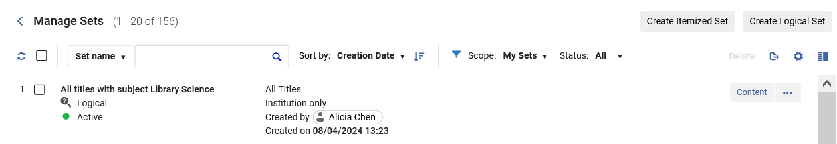
Creating the Logical Query
The set has been created

Slide 13
Creating the Logical Collection

Slide 14
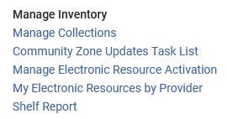
Creating the Logical Collection
The Logical Title Level Collection will be created like other title level collections at “Resources > Manage Inventory > Manage Collections”

Slide 15
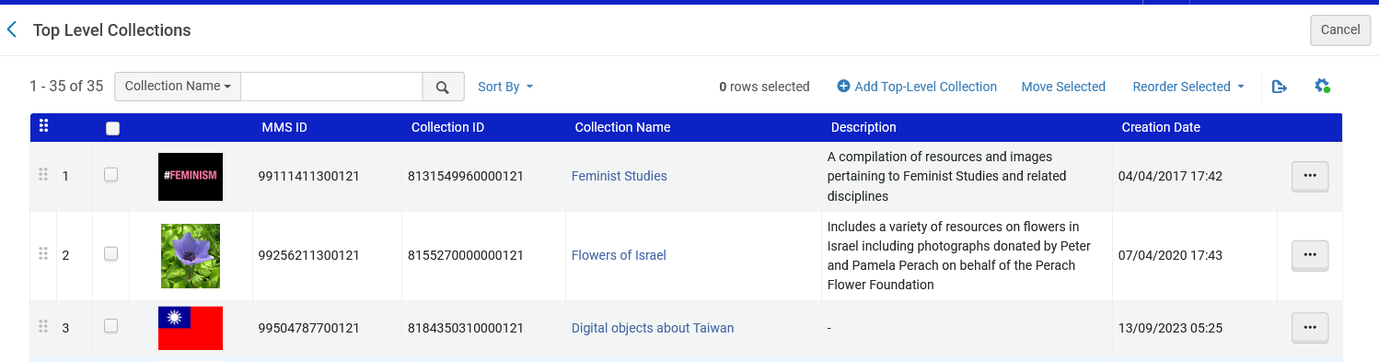
Creating the Logical Collection
We will add a new top-level collection

Slide 16
Creating the Logical Collection
On the next slide we are adding a new Top-Level Collection called “Resources about Library Science”.
We are checking the checkbox “Logical Collection” to designate this as a Logical Collection”.

Slide 17
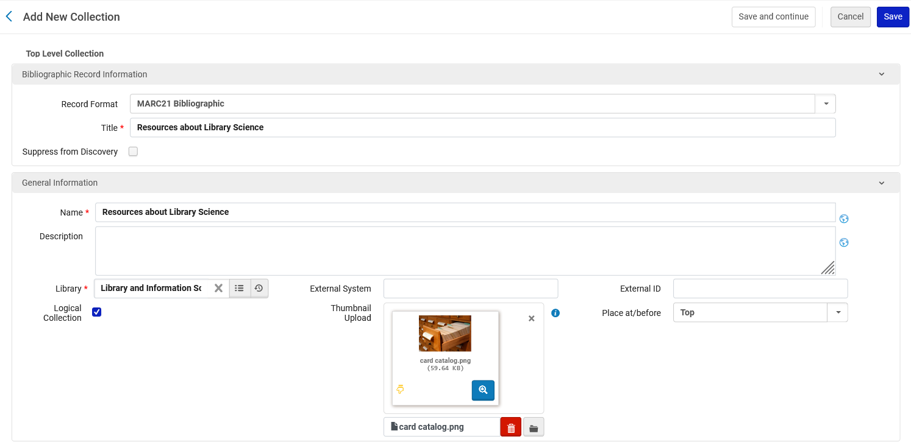
Creating the Logical Collection
Designate this title level collection as a logical collection

Slide 18
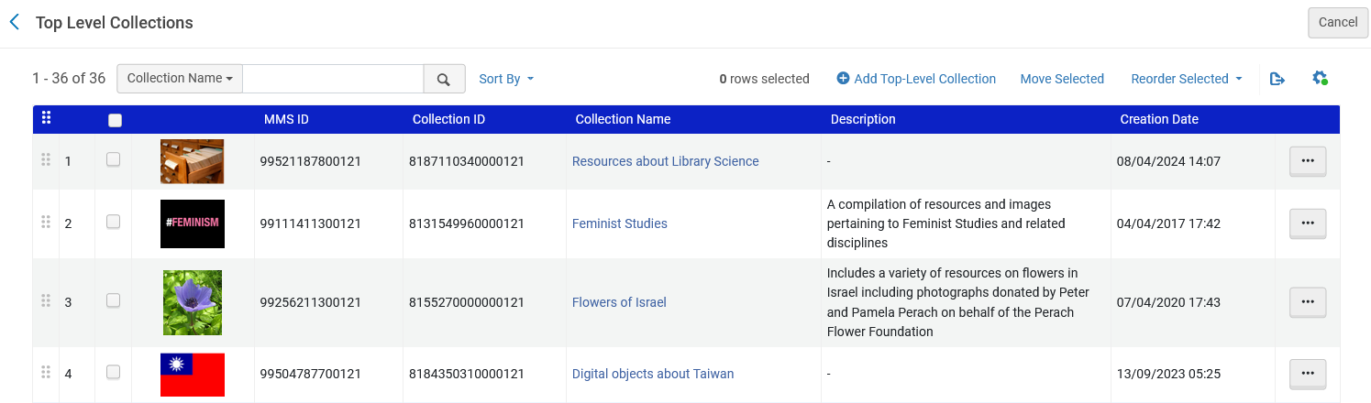
Creating the Logical Collection
Here is our new Logical Title Level Collection

Slide 19
Attributing a Set to the Logical Collection

Slide 20
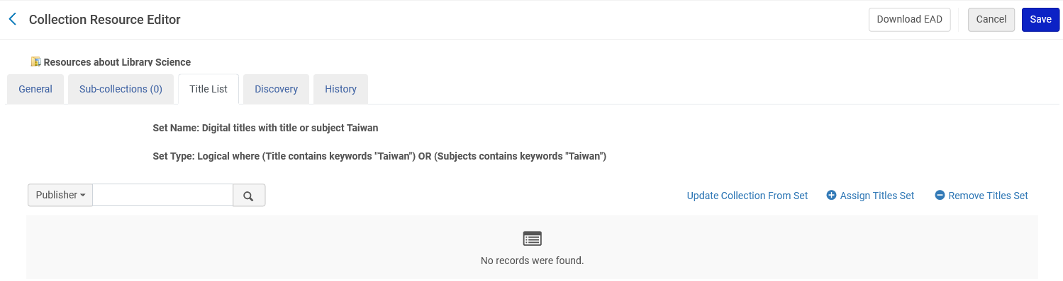
Attributing a Set to the Logical Collection
From the “Titles List” tab we click “Assign Titles Set” to attribute the set we made called “All titles with subject Library Science” to this Logical Title Level Collection.

Slide 21
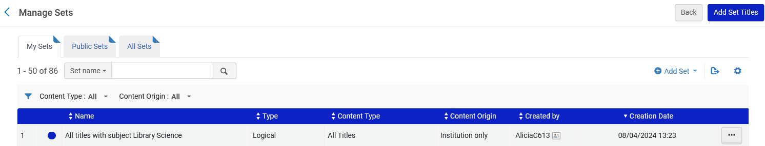
Attributing a Set to the Logical Collection
Now we will choose the desired set

Slide 22

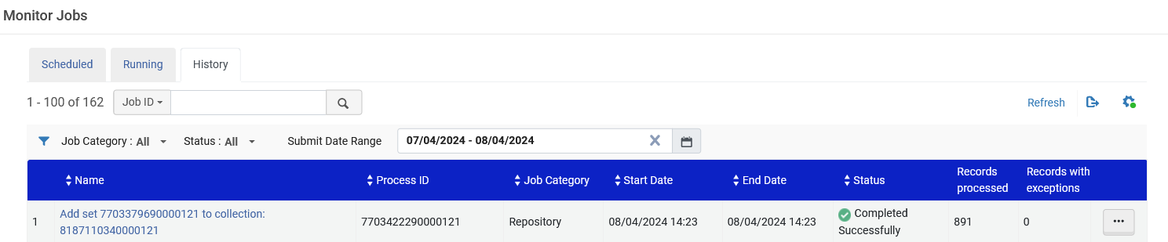
Attributing a Set to the Logical Collection
A job runs to add the titles from the logical set to the Logical Title Level Collection

Slide 23
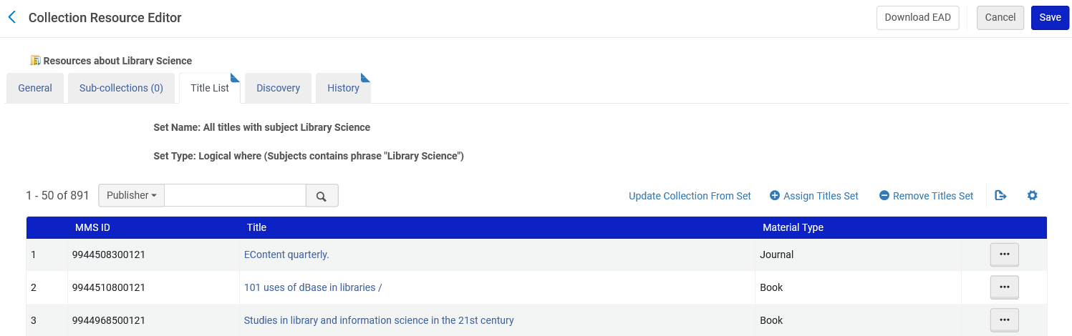
Attributing a Set to the Logical Collection
After attributing the logical set to the Logical Title Level Collection all of the titles from the set get added to the logical collection
This is the query of the set we created earlier
All 891 titles from the set have been added to the logical collection

Slide 24
Ongoing Update of the Collection From the Set

Slide 25
Ongoing Update of the Collection From the Set
As titles get added or removed from the logical set they also get added or removed from the Logical Title Level Collection (this is the significant time saver of this feature).
The synchronization of the titles from the logical set to the Logical Title Level Collection is done in one of two ways:
  When the nightly job “Synchronize All Logical Collections Job” runs
  When the staff user clicks “Update Collection From Set

Slide 26
Ongoing Update of the Collection From the Set
The staff user can click “Update Collection From Set” if he or she does not want to wait for the scheduled job “Synchronize All Logical Collections Job” to run

Slide 27
Ongoing Update of the Collection From the Set
For the job “Synchronize All Logical Collections Job” to be scheduled to run at the institution the staff user needs to do as follows (just once):
  Access “Resource Management Jobs Configuration” at “Configuration > Resources > Other”
  In the “Synchronize All Logical Collections Job” change the status to “Active”
On the next slide we will discuss the “Default Collection”

Slide 28
Ongoing Update of the Collection From the Set
The “Default Collection” is the Title Level Collection to which the records from Logical Title Level Collection will be assigned if the designated Logical Title Level Collection will be deleted.
For example, in our case if the Logical Title Level Collection “Resources about Library Science” were deleted, then all titles that were in the set would be assigned to Title Level Collection “Miscellaneous Digital Items”

Slide 29
Ongoing Update of the Collection From the Set
Let’s see what happens when a new title is added to the logical set “Resources about Library Science”.
Currently there are 891 titles from the set in the Logical Title level Collection

Slide 30
Ongoing Update of the Collection From the Set
On the next slide we add a new record with title “Glossary of library and information science : English-Chinese, Chinese-English / Su Chen, Shi Deng.”
This title has subject “Library Science”.
It should therefore get added to the logical set “All titles with subject Library Science” and then subsequently to the Logical Title level Collection “Resources about Library Science”

Slide 31
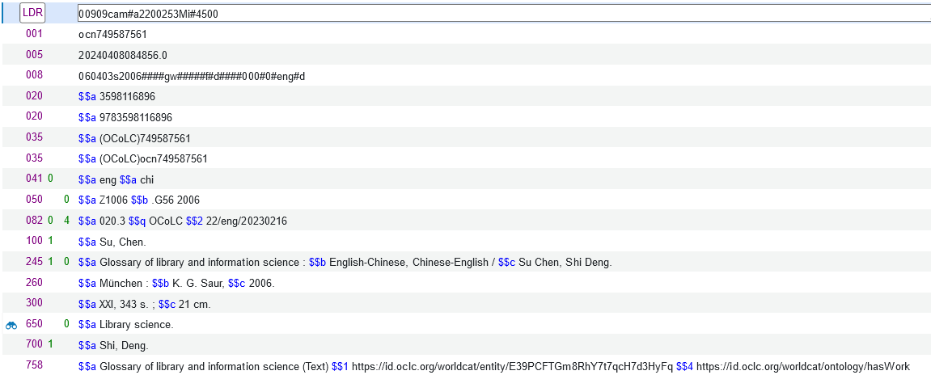
Ongoing Update of the Collection From the Set

Slide 32
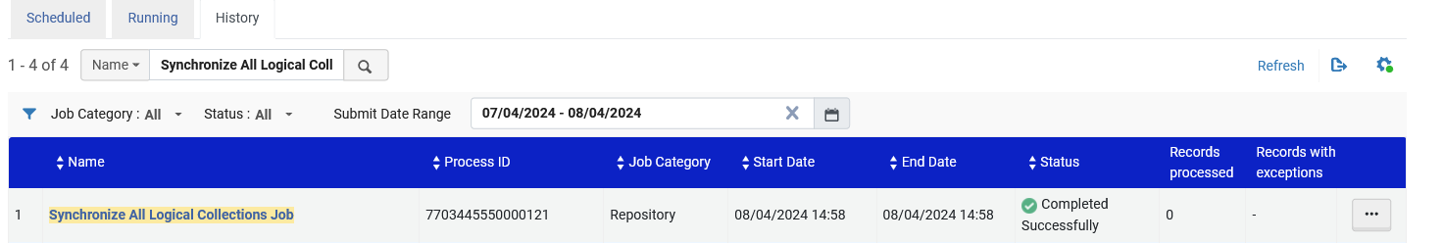
Ongoing Update of the Collection From the Set
In order for the new record to get added to the logical collection one of two events needs to happen:
  The scheduled job “Synchronize All Logical Collections Job” runs
  The staff user clicks “Update Collection From Set” rom the Titles List of the Logical Title level Collection
The scheduled job “Synchronize All Logical Collections Job” has run

Slide 33
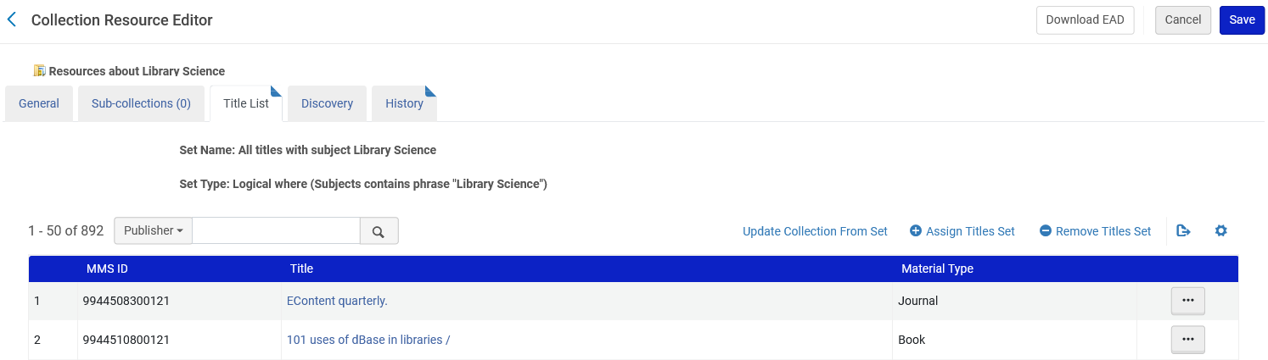
Ongoing Update of the Collection From the Set
The title was added. Now there are 892 titles in the Logical Title level Collection “Resources about Library Science”. Previously there were 891 titles.

Slide 34
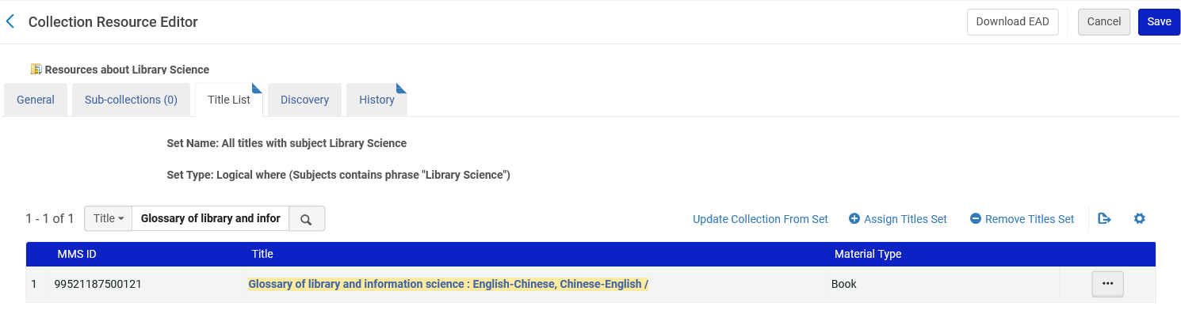
Ongoing Update of the Collection From the Set
Here is the new title that we added to the repository, it is in the Logical Title Level Collection:

Slide 35
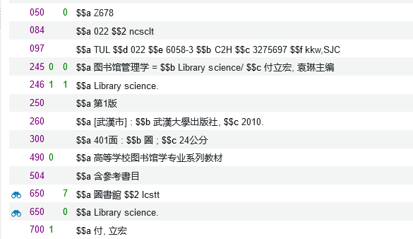
Ongoing Update of the Collection From the Set
Again, we will add a new title to the repository which has subject “Library science”. It is title “图书馆管理学 = Library science/ 付立宏, 袁琳主编”

Slide 36
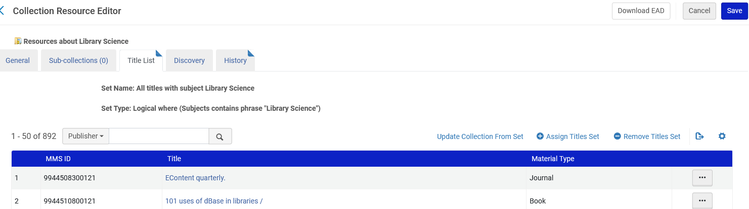
Ongoing Update of the Collection From the Set
Now, instead of waiting for the scheduled job “Synchronize All Logical Collections Job” to run, we will click “Update Collection From Set” from the “Title List” tab of the Logical Title Level Collection.
Note that now there are 892 titles in the Logical Title Level Collection

Slide 37
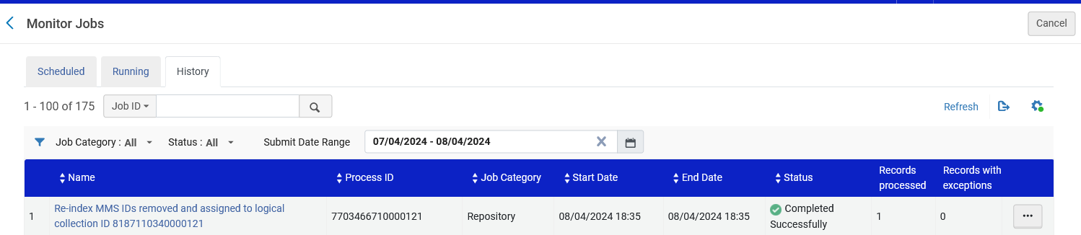
Ongoing Update of the Collection From the Set
A job is sent and completes. The job updates the Logical Title Level Collection.

Slide 38
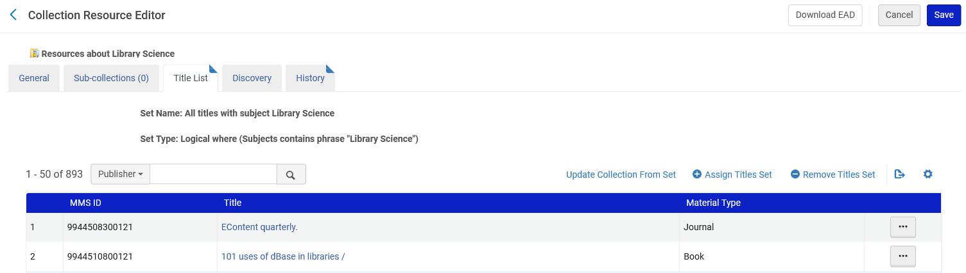
Ongoing Update of the Collection From the Set
The title was added. Now there are 893 titles in the Logical Title level Collection “Resources about Library Science”. Previously there were 892 titles.

Slide 39
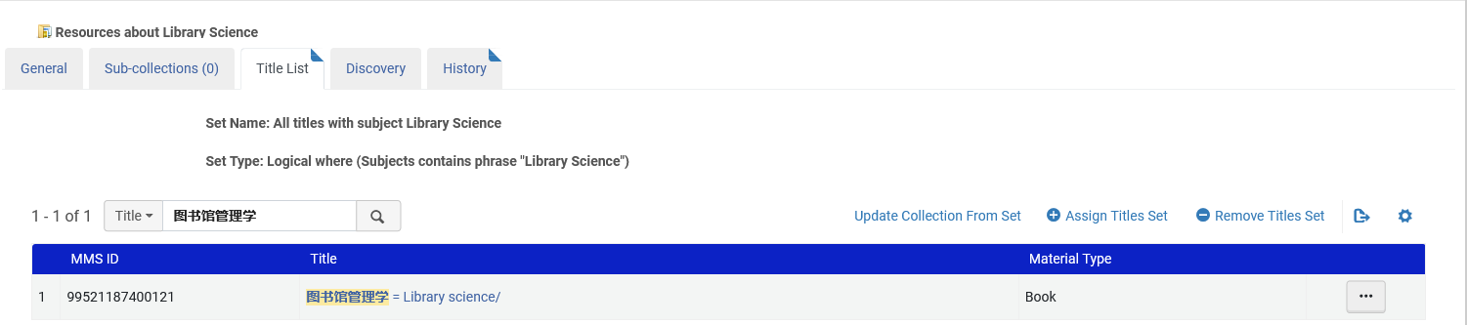
Ongoing Update of the Collection From the Set
Here is the new title that we added to the repository, it is in the Logical Title Level Collection:

Slide 40
The Logical Title Level Collection in Discovery

Slide 41

The Logical Title Level Collection in Discovery
In Primo VE we will access “Collection Discovery”

Slide 42
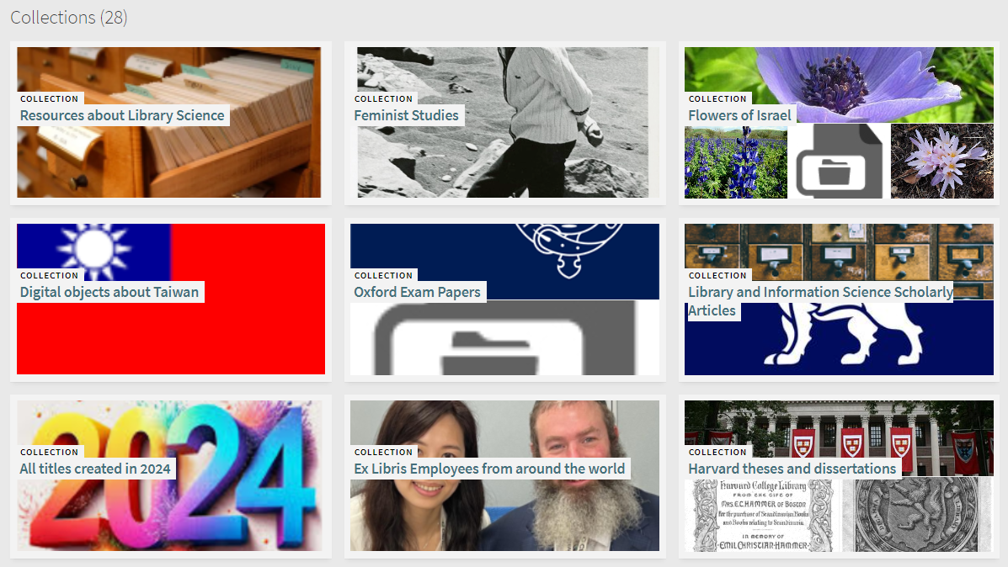
The Logical Title Level Collection in Discovery
We see the title level collections
Here is our Logical Title Level Collection. We will click it.

Slide 43
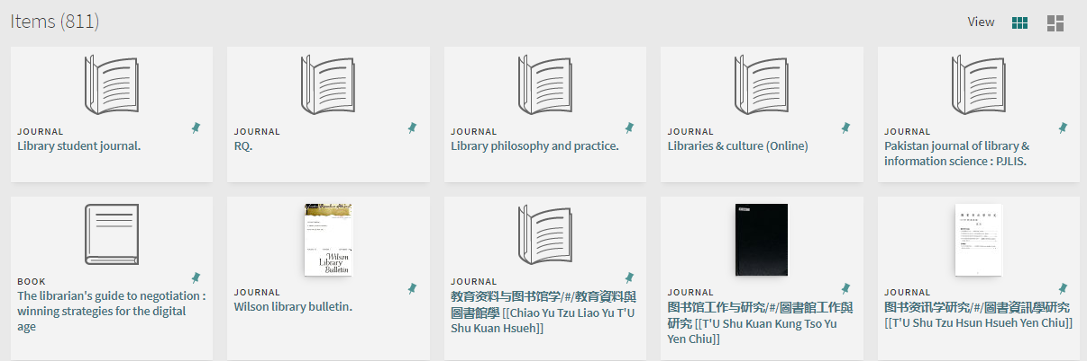
The Logical Title Level Collection in Discovery
Now we have the contents of the collection
We will click this resource

Slide 44
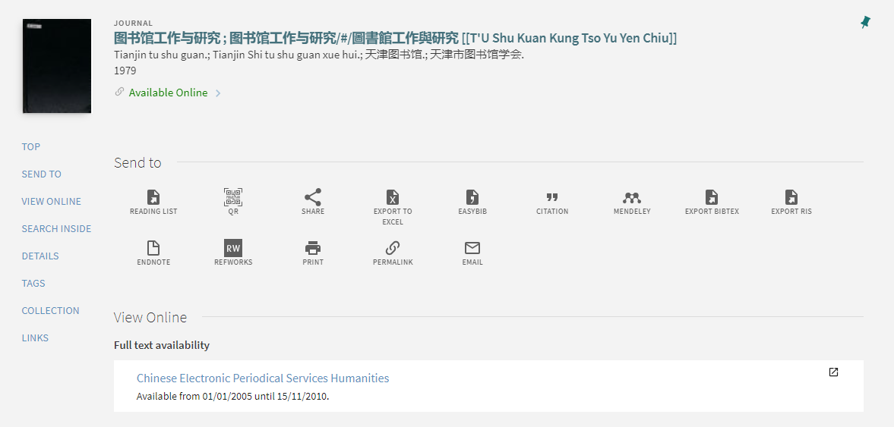
The Logical Title Level Collection in Discovery
And now we have the details of the resource and can access it

